Slide 1
Object Oriented Programming Lab # 01
Introduction to Java
Engr. Saniya Sarim

Slide 2
What is OOP?
OOP stands for Object-Oriented Programming.
Procedural programming is about writing procedures or methods that perform operations on the data, while object-oriented programming is about creating objects that contain both data and methods.

Slide 3
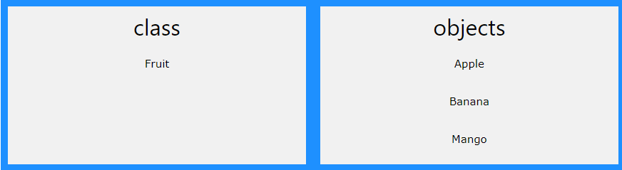
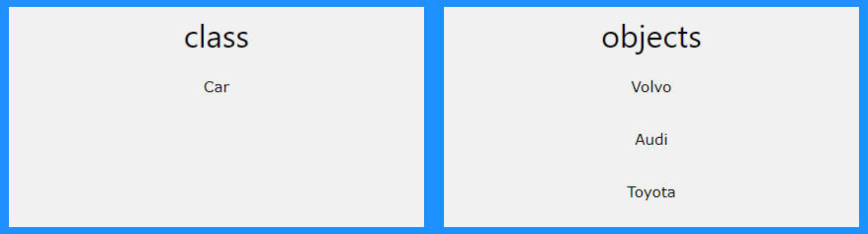
Classes and Objects
Classes and objects are the two main aspects of object-oriented programming.
Look at the following illustration to see the difference between class and objects:
So, a class is a template for objects, and an object is an instance of a class.
When the individual objects are created, they inherit all the variables and methods from the class.

Slide 4
Introduction to Java
Java is an object-oriented programming language.
Everything in Java is associated with classes and objects, along with its attributes and methods. For example: in real life, a car is an object. The car has attributes, such as weight and color, and methods, such as drive and brake.
A Class is like an object constructor, or a "blueprint" for creating objects.

Slide 5
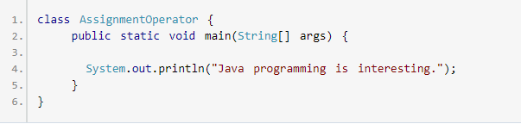
How to display output in JAVA?

Slide 6

Output

Slide 7
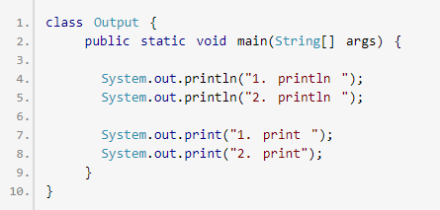
Example 2: print() and println()

Slide 8


Java Input
For that, you need to import Scanner class using:
Then, we will create an object of Scanner class which will be used to get input from the user.

Slide 9
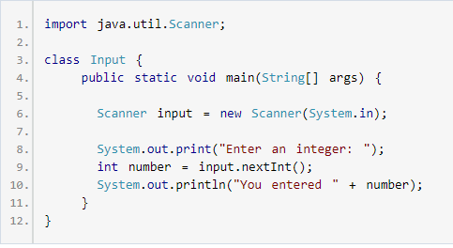
Get Integer Input From the User

